Slide 1

British Airways
Case Study
-by Samudra Roy

Slide 2
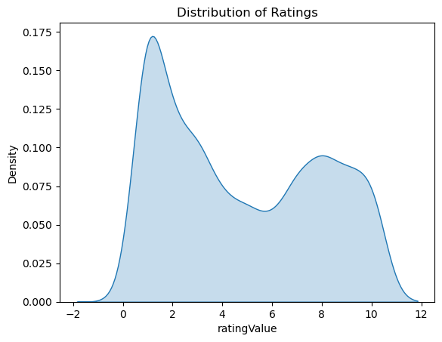
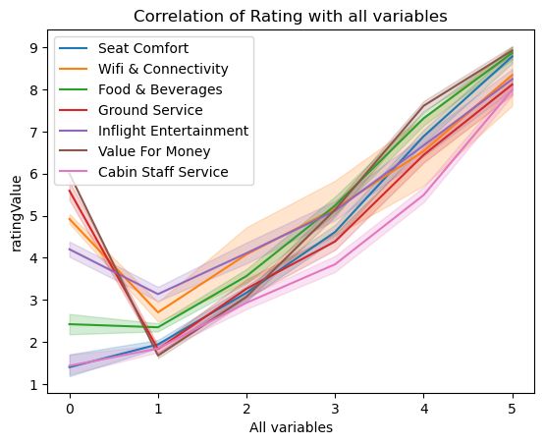
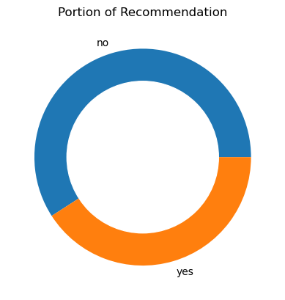
Most passengers are unsatisfied as most of them gave a rating between 0 to 2
Passengers tend to give better ratings if they get better:
Seat Comfort
Wifi and Connectivity
Food & Beverages
Ground Service
Inflight Entertainment
Value For Money
Cabin Staff Service
Most people chose not to recommend flying in British Airways.

